Slide 1
High School Start Time
Thought Exchange Community Engagement
SYOSSET CENTRAL SCHOOL DISTRICT

Slide 2
WHAT IS IMPORTANT FOR THE DISTRICT TO CONSIDER AS WE EXPLORE POTENTIALLY SHIFTING TO A LATER HIGH SCHOOL START TIME?
OVERVIEW OF ENGAGEMENT
Please choose the school level you are most closely associated with. If you have children in more than one school, select the level of your youngest child.
How do you most closely identify with the District?
Parent/Guardian | 1,505 | 71%
Staff Member | 427 | 20%
Student | 164 | 8%
Community Member | 12 | 1%
Elementary | 845 | 40%
Middle School | 431 | 21%
High School | 801 | 38%
Not Applicable | 27 | 1%

Slide 3
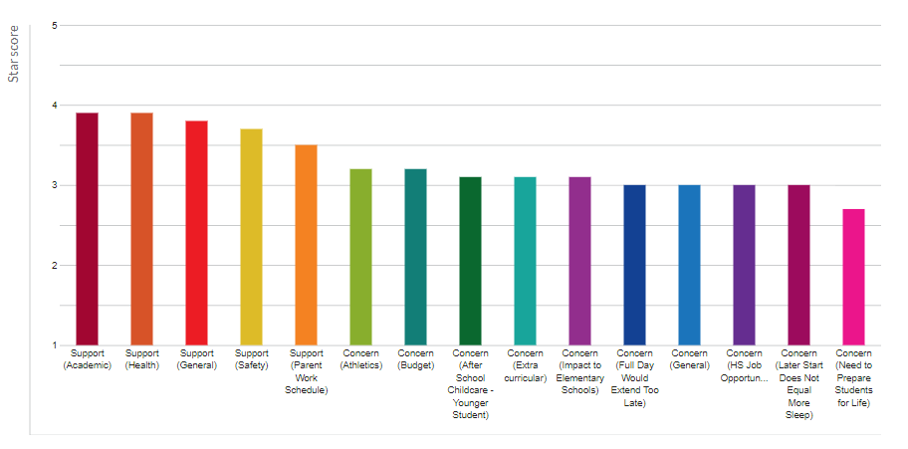
THOUGHTS CATEGORIZED BY SUPPORT OR CONCERN, AND REASON GIVEN
Thoughts expressing support for a later high school start time were consistently rated higher than those expressing concern.

Slide 4
10 HIGHEST RATED THOUGHTS - OVERALL
Ability of children to get enough sleep. Learning requires sufficient rest.
Ranked #1 of 1,984; 4.6 stars
The District should consider the research on teenagers getting more sleep and the effect on grades, health and emotional well being.
Ranked #7 of 1,984; 4.4 stars
Sufficient sleep duration. Sufficient sleep impacts academic performance and learning.
Ranked #2 of 1,984; 4.6 stars
I think it is extremely important for district to consider a later start time for the HS. Students are up late with sports and after school activities and heavy load of homework and studying. They could benefit from sleeping more.
Ranked #8 of 1,984; 4.4 stars
Most high school students stay up late to complete their homework and have late activities and sports that sometimes keep them out until 10 pm. A later start time would give HS students more time to sleep. They need their sleep because they are up late.
Ranked #3 of 1, 984; 4.6 stars
Less sleep affects their performance in school during the years where their grades directly affect their college acceptance chances. Younger students go to sleep earlier anyway, which means it would be easier for them to get up earlier.
Ranked #9 of 1,984; 4.4 stars
These teens need additional sleep. Sleep deprivation impairs ability to learn.
Ranked #4 of 1,984; 4.5 stars
Sleep is important to everyone and I know that my high schoolers lack it!!
Ranked #5 of 1,984; 4.5 stars
Older students have heavier work loads. Between activities and homework, high school students go to bed very late. Having to wake up at 6 am leaves them chronically fatigued which leads to poorer performance, difficulty with concentrating and additional stress.
Ranked # 10 of 1,984; 4.4 stars
Better sleep helps in retention. High School start time is cruel especially in winter. Students will have more quality time spared for family after finishing homework and extra activities, rehearsals, etc.
Ranked #6 of 1,984; 4.4 stars

Slide 5
10 LOWEST RATED THOUGHTS - OVERALL
The later start time is unnecessary. It will just hurt after school activities. We should teach the students to wake up early. The most successful people wake up early and get started with their day early. Students waking up early is a habit for the rest of their lives.
Ranked #1,982 of 1,984; 2.0 stars
No need to change…Why? Kids have survived years doing it this way. Gets them ready for life. Get up and go to work. Also…Go to school later…means stay up later with all electronics, etc.
Ranked #1,977 of 1,984; 2.1 stars
My family do not prefer a late high school start time.
Ranked #1,981 of 1,984; 2.0 stars
If you start later, how can they get adjusted to 7:30 am classes in college? Grow up parents please. Stop coddling.
Ranked #1.976 of 1,984; 2.1 stars
We already have poor planning in regards to the calendar: why is the Feb break offset by shorter April break. Additionally, this school need not address every ethnic holiday.
Ranked #1,980 of 1,984; 2.1 stars
There are no solutions in life just trade offs. I don’t think the earlier start time will solve the problems/challenges students are facing.
Ranked #1,975 of 1,984; 2.2 stars
I don’t think the time should be changed at all. As the saying goes “If it ain’t broke don’t try to fix it”. Toughens you up for the real world.
Ranked #1,979 of 1,984; 2.1 stars
This should not even be considered. Extra help – am – sports – activities – plays – PM – the kids will not be here much longer.
Ranked #1,974 of 1,984; 2.2 stars
It is important to consider why this change is even being looked at now, when school times have been pretty consistent for decades. If the system has worked fine in Syosset for decades, and we continue to be one of the highest performing schools in the state/county, why change?
Ranked #1,977 of 1,984; 2.1 stars
I oppose the later start time for high school. That age has more on their plate for homework, extracurricular activities and for some getting their first job.
Ranked #1,973 of 1,984; 2.2 stars

Slide 6
AREAS OF DIVISION
“Side A” rate these thoughts high:
“Side B” rate these thoughts high:
This is a positive move in helping the children of our district excel academically. Additional sleep, having time for breakfast and more vibrant children will be able to focus and concentrate more effectively.
Side A: 4.9 stars; Side B: 1.0 star
High School is too early.
Side A: 4.6 stars, Side B: 1.0 star
I think the District should implement a later start time. The later start time would allow for extra sleep which can improve grades and overall health.
Side A: 5.0 stars; Side B: 1.0 star
Later start time is better so kids can sleep well. Good sleep is better for health.
Side A: 4.9 stars; Side B: 1.6 stars
The positive effect on the students. They will get more sleep.
Side A: 5.0 stars; Side B: 1.8 stars
If you start later, how can they get adjusted to 7:30 am classes in college? Grow up parents please. Stop coddling.
Side A: 1.0 star; Side B: 4.6 stars
Children are resilient if they are put in situations where they are not coddled/pampered consistently. We shouldn’t jump to give them the “easy path”. Life is not always easy. We need to teach them at an early age that they will have to adapt. Giving them more sleep time just coddles them further.
Side A: 1.2 stars; Side B: 4.9 stars
Teacher childcare concerns. If we end later who will be home for my children to get off the bus as they are also Syosset students and will get home earlier than me.
Side A: 1.3 stars; Side B: 5.0 stars
The later start time in unnecessary. It will just hurt after school activities. We should teach the students to wake up early. The most successful people wake up early and get started with their day. Students waking up early is a habit for the rest of their lives.
Side A: 1.1 stars; Side B: 5.0 stars

Slide 7
AREAS OF AGREEMENT
Both sides rated these thoughts high:
Sufficient sleep duration. Sufficient sleep directly impacts academic performance and learning.
Side A: 4.9 stars; Side B: 4.0 stars
I think it’s most important to consider what is best for the students.
Side A: 4.6 stars, Side B: 3.4 stars
High schoolers potentially have jobs or are involved in activities/sports that go late. Example – high school ice hockey team has practice starting at 9:45 pm. Kids are not getting home until 11/11:30 and having to get up for school before 6 am and sit through a school day is very often an issue.
Side A: 4.4 stars; Side B: 5.0 stars
Sports competition/game conflicts are not a big problem. Yes, practices will start and end later but that’s part of being an athlete: being busier. For conflicts with other schools, take Jericho for example. Other schools will find ways to compromise whether it involves waiting or changing time.
Side A: 4.7 stars; Side B: 4.5 stars
I have a high school student he gets on the bus at 6:30 am and plays sports sometimes very late. The days are so long. Not enough sleep he has ADHD & takes medicine. Sleep is important.
Side A: 4.8 stars; Side B: 3.7 stars
The amount of sleep our students receive is extremely important but we also need to investigate how a later start time will equate to a later end time.
Side A: 4.0 stars; Side B: 5.0 stars

Slide 8
HOW STAFF RATED THOUGHTS
Highest-Rated Thoughts by Staff:
Later end times are going to equate to students getting to sleep later. Since extra curricular activities are stressed so much in the college application process, more students are participating in more after school events.
Rating by staff: 4.3 stars
I think the families of the high school students need to step up and make sure their kids go to bed at a reasonable time so they get the right sleep. This has to be a partnership and the school should not be the only ones to make such a huge change.
Rating by staff: 4.2 stars
Impact on elementary children. How much extra time will younger children need to be in an after care program?
Rating by staff: 4.2 stars
Lowest-Rated Thoughts by Staff:
Often high schoolers have jobs after school. Often HS students babysit & taking elementary students off the bus as part of their babysitting job.
Rating by staff: 2.0 stars
Late start time won’t make a difference in the students’ well being. They continue to stay up late playing games and spending time on social media. They’ll be sleep deprived regardless.
Rating by staff: 2.0 stars
If someone has to pay for any increase in costs, it has to come from the pocket of the administrators, not parents!! Teachers/administrators are being overpaid as is, while us parents have to spend money on tutors teaching the kids what they should already by taught!
Rating by staff: 2.0 stars

Slide 9
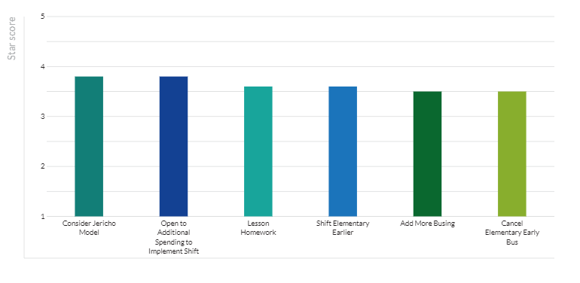
THOUGHTS THAT INCLUDED AN OPINION ON AN ACCEPTABLE COMPROMISE
Different compromises mentioned were rated fairly consistently, receiving a star score between 3.5 and 3.8 on average).

Slide 10
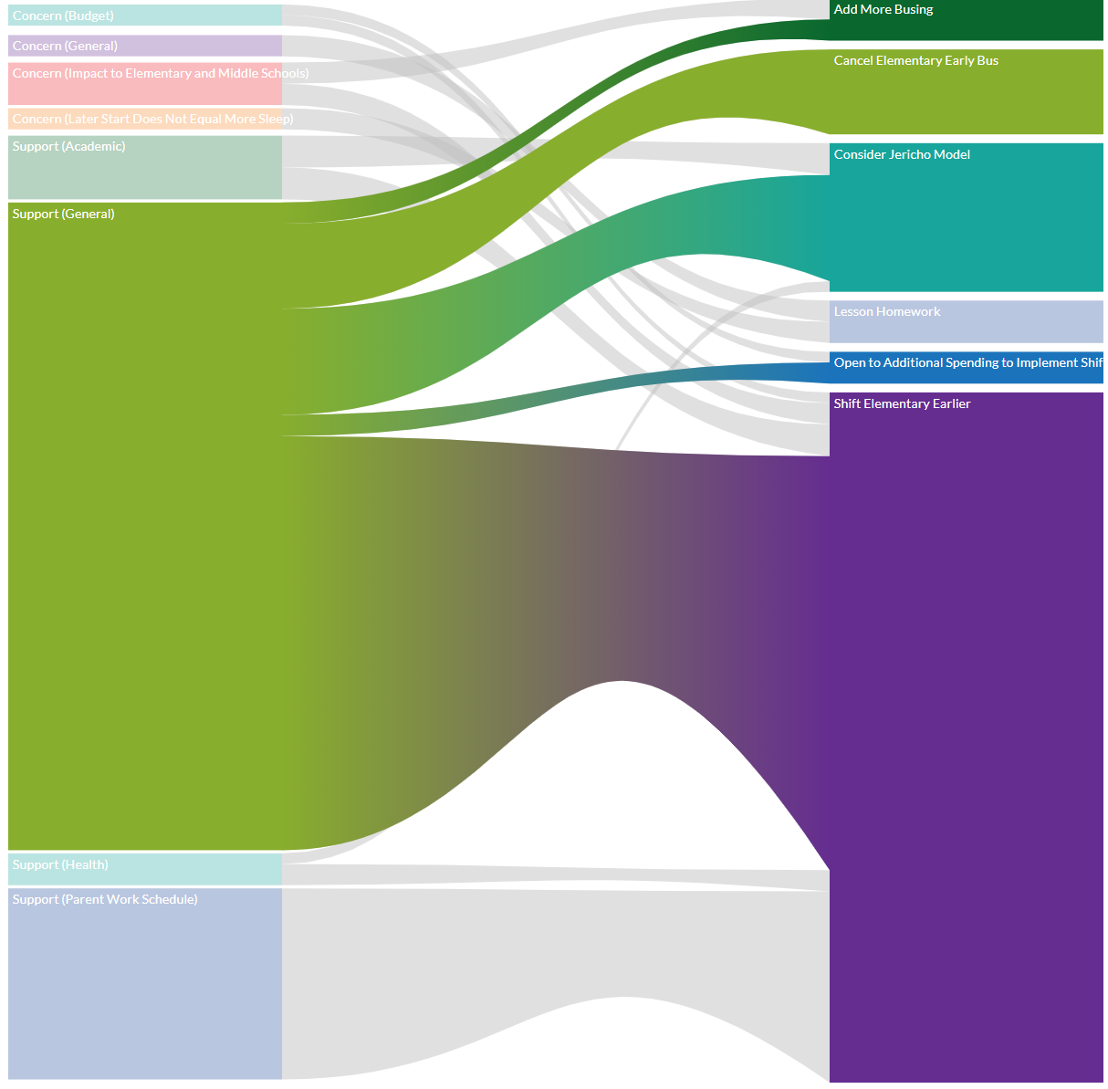
Correlation of Thoughts to Compromises
More Busing
Concern
Support
Move Elementary Start Time

Slide 11
Next Steps
Develop concrete options
Seek feedback on specific options
There will be no option that doesn't require some compromise.
Cost out changes
Develop implementation timeline
Fall 2021 at the earliest

Slide 12
